Slide 1
Fuel Economy Data Analysis Model Year 2019
Jhony Maurad

Slide 2
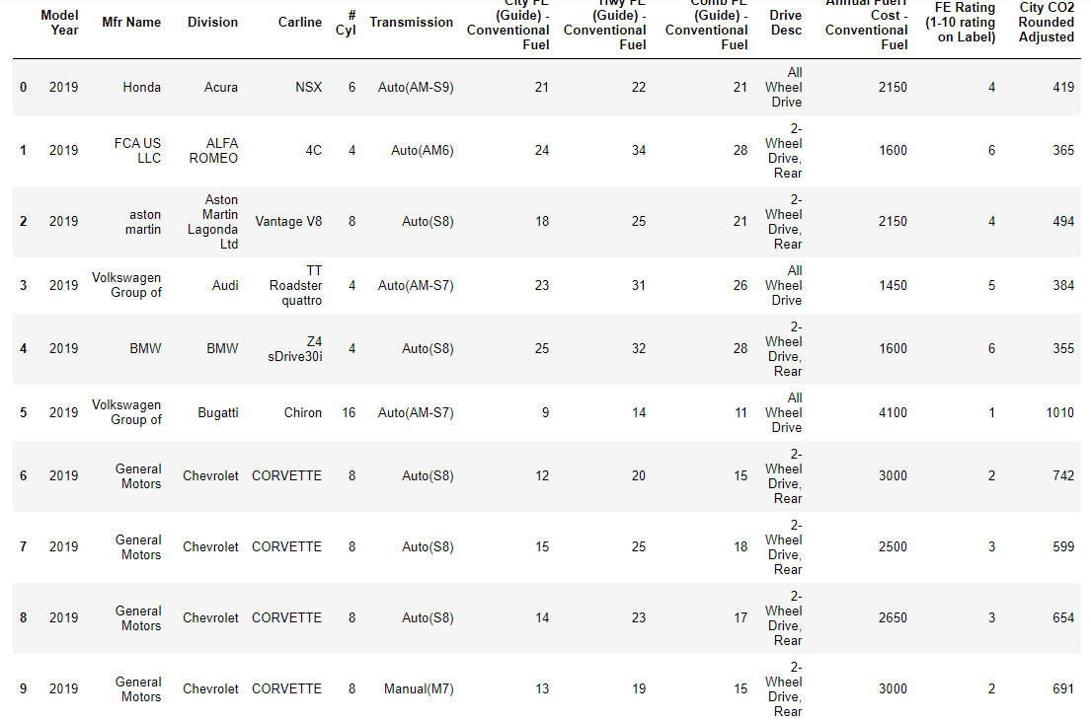
The U.S. Environmental Protection Agency (EPA) and U.S. Department of Energy (DOE) produce the Fuel Economy Guide
The purpose of EPA’s fuel economy estimates is to provide a reliable basis for comparing vehicles
To help car buyers choose the most fuel-efficient vehicle that meets their needs
The average household spends about one-fifth of its total family expenditures on transportation, making it the second most expensive category after housing

Slide 3
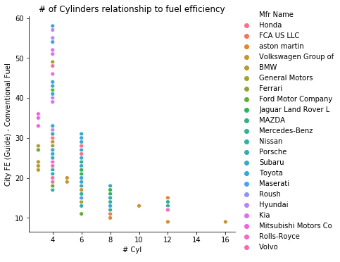
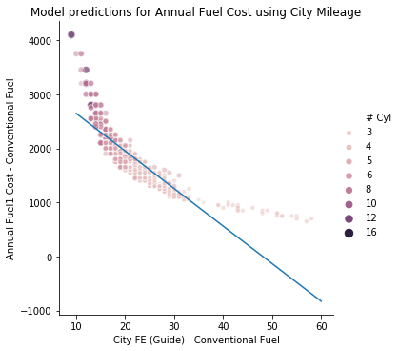
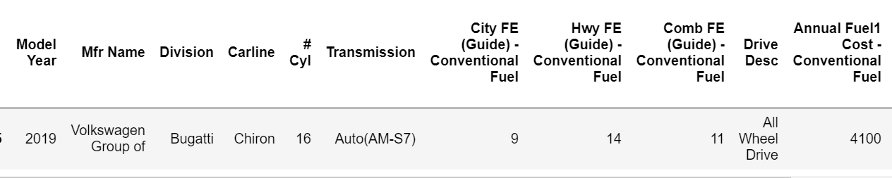
Interesting findings?
RELATIONSHIIPS
LINEAR REGRESION
As the number of cylinder increases fuel efficiency decreases
Unsurprisingly, as fuel efficiency increases, the annual fuel cost for the car decreases.

Slide 4
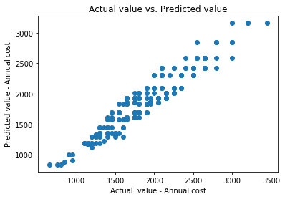
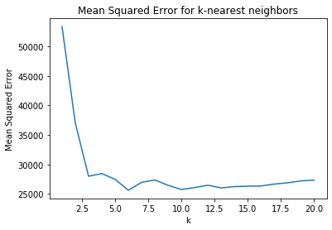
Using k-nearest neighbors with k = 3, the mean square error is: 27993.827160493805;
Which is lower than using a decision tree with depth 3.
Mse: 31123.84041091141
k = 6, will give me the lowest mean square error
https://sites.google.com/view/jhony-maurad-data-science-fuel/home

